Slide 1



Week 2
EXPLORATORY DATA ANALYSIS
https://intip.in/EDAIUP2022
Teaching Assistant :
Bramandika (06211940000059)
Maura Putri Defa (06211940000139)
Sepuluh Nopember Institute of Technology, Surabaya - Indonesia

Slide 2
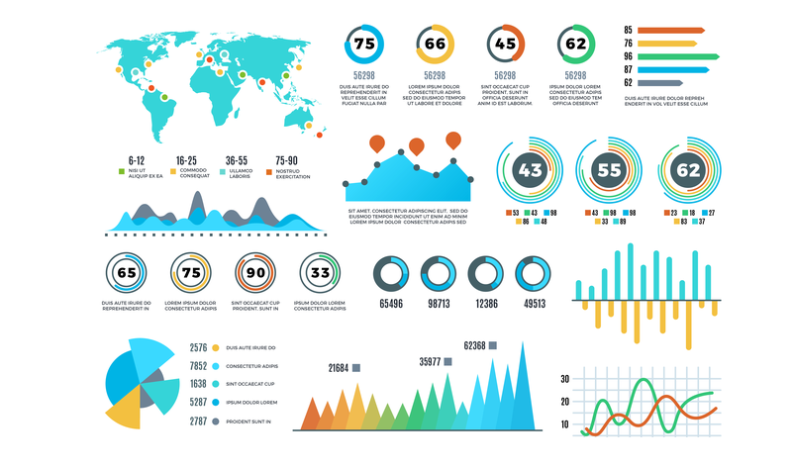
Data Visualization

Slide 3
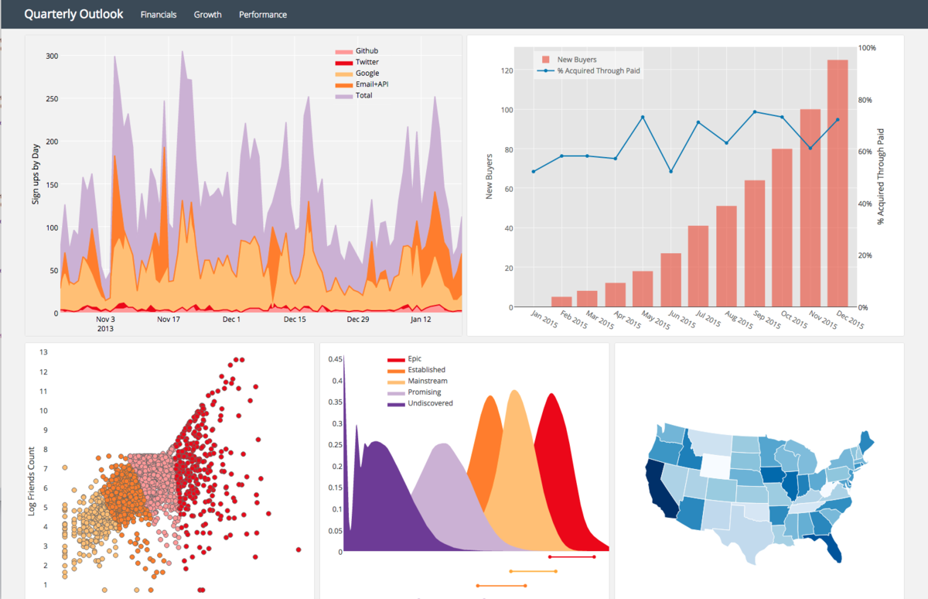
Data visualization is the graphical representation of information and data. By using visual elements like charts, graphs, and maps, data visualization tools provide an accessible way to see and understand trends, outliers, and patterns in data.

Slide 4
Why Visualize Data?
1
4
Humans generally poor at gaining insight from data in numerical form
03
04
Extend capacity of memory – puts in front of eyes what we couldn’t otherwise hold in mind
2
02
05
5
Close relationship between vision & cognition
Allows you to explore and make sense of data, and communicate information
06
3
01
6
Make patterns, trends, exceptions visible and understable
Can help with hypothesis generation

Slide 5
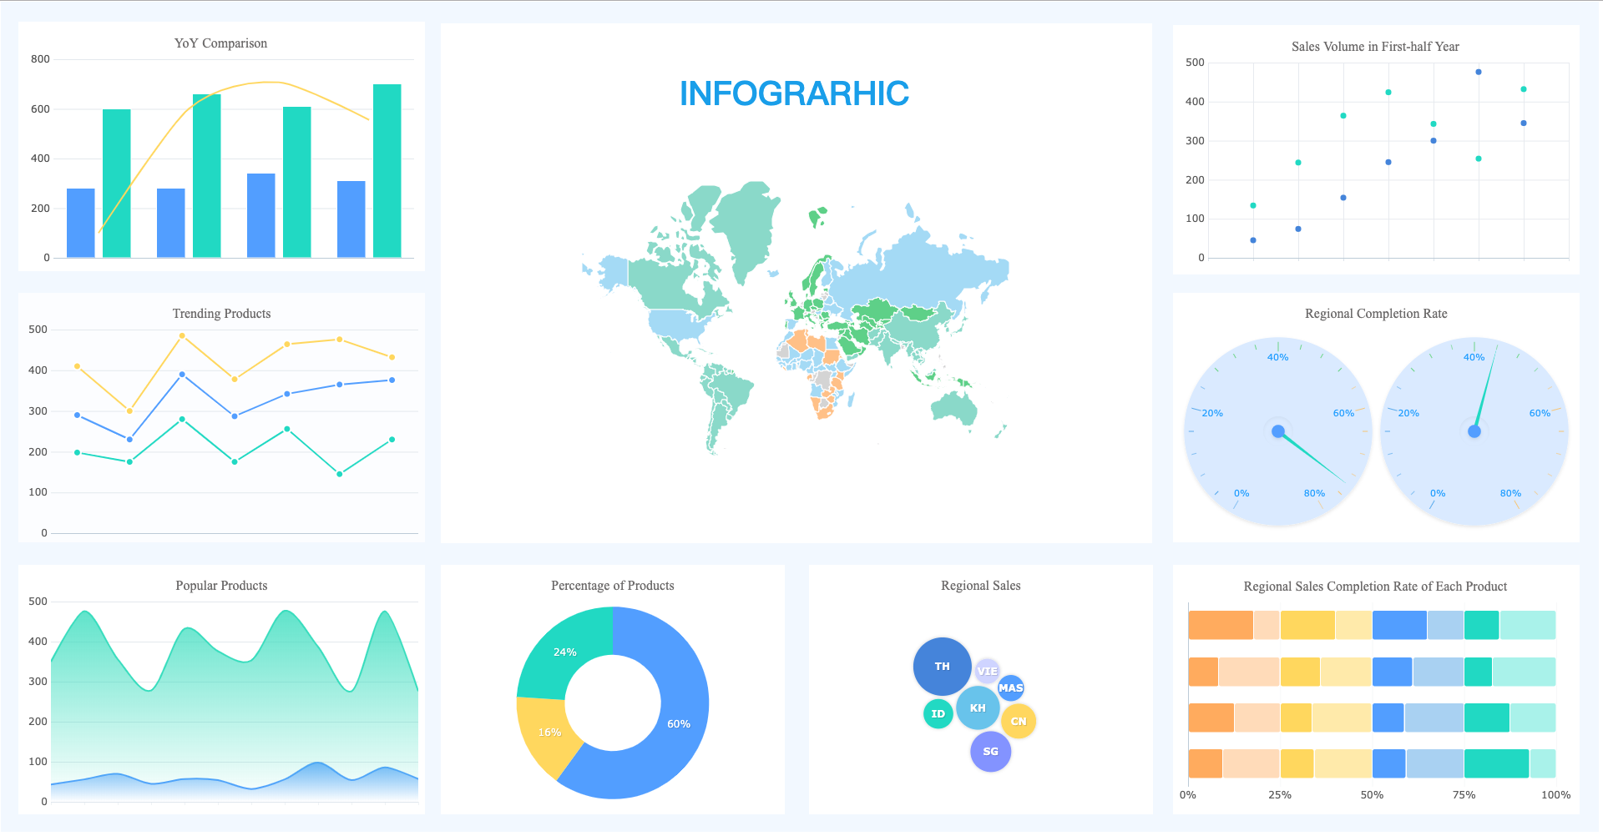
Graphical techniques that we used in Exploratory Data Analysis

Slide 6
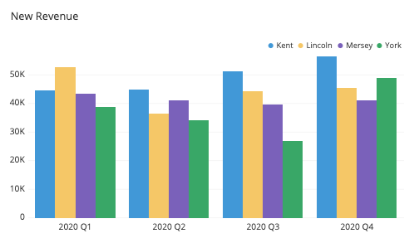
Bar Chart
A bar chart (bar graph, column chart) plots numeric values for levels of a categorical feature as bars. Levels are plotted on one chart axis, and values are plotted on the other axis. Each categorical value claims one bar, and the length of each bar corresponds to the bar’s value. Bars are plotted on a common baseline to allow for easy comparison of values.

Slide 7
When you should use a bar chart?
A bar chart is used when you want to show a distribution of data points or perform a comparison of metric values across different subgroups of your data. From a bar chart, we can see which groups are highest or most common, and how other groups compare against the others.

Slide 8
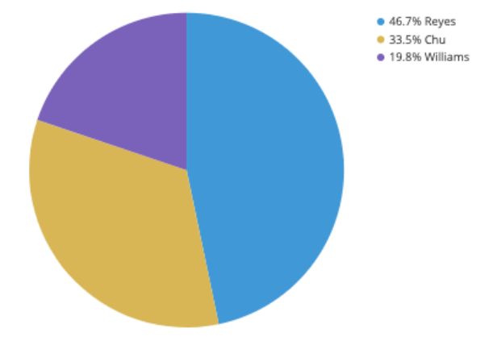
Pie Chart
A pie chart shows how a total amount is divided between levels of a categorical variable as a circle divided into radial slices. Each categorical value corresponds with a single slice of the circle, and the size of each slice (both in area and arc length) indicates what proportion of the whole each category level takes.

Slide 9
When you should use a pie chart?
In order to use a pie chart, you must have some kind of whole amount that is divided into a number of distinct parts. Your primary objective in a pie chart should be to compare each group’s contribution to the whole, as opposed to comparing groups to each other. If the above points are not satisfied, the pie chart is not appropriate, and a different plot type should be used instead.

Slide 10
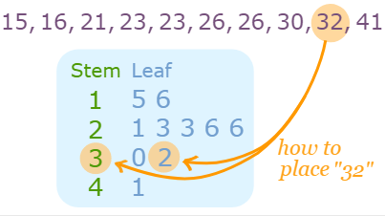
Steam and Leaf
A plot where each data value is split into a "leaf" (usually the last digit) and a "stem" (the other digits).
The “stem” values are listed down, and the “leaf” values are listed next to them. The "stem" is used to group the scores and each "leaf" shows the individual scores within each group.

Slide 11
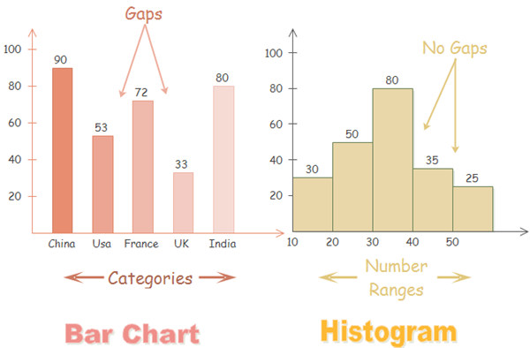
Histogram
A histogram is a bar graph that represents a frequency distribution. The width represents the interval and the height represent the corresponding frequency
Compare Bar Graph and Histogram
Histogram are used to show distribution of variables whereas bar charts are used to compare variables.

Slide 12
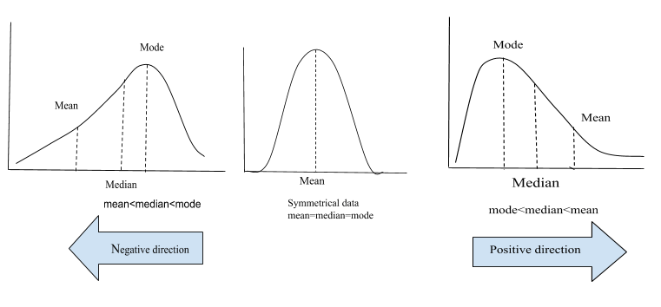
Skewness

